Slide 1
Vision Zero

Slide 2

GOOD WORK FOR GOOD LIFE
©Pixabay

Slide 3
BUT WORK HAS OTHER FACES

Slide 4
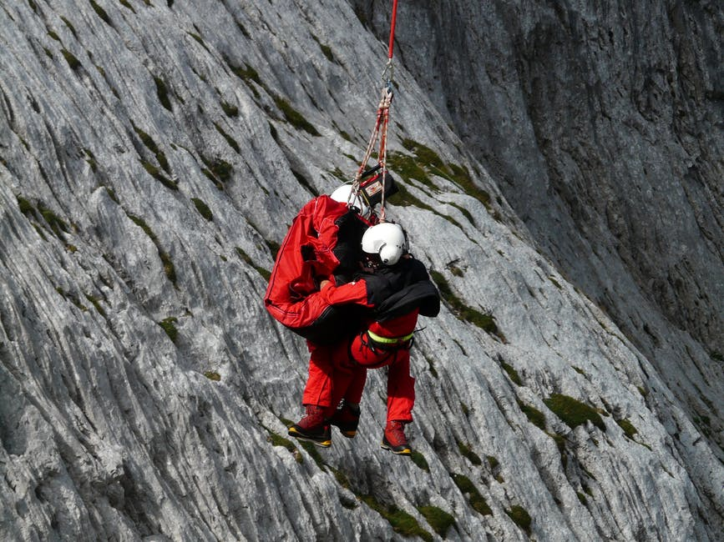
WORK HURTS
©Pixabay

Slide 5

WORK MAKES YOU SICK
©Pixabay

Slide 6
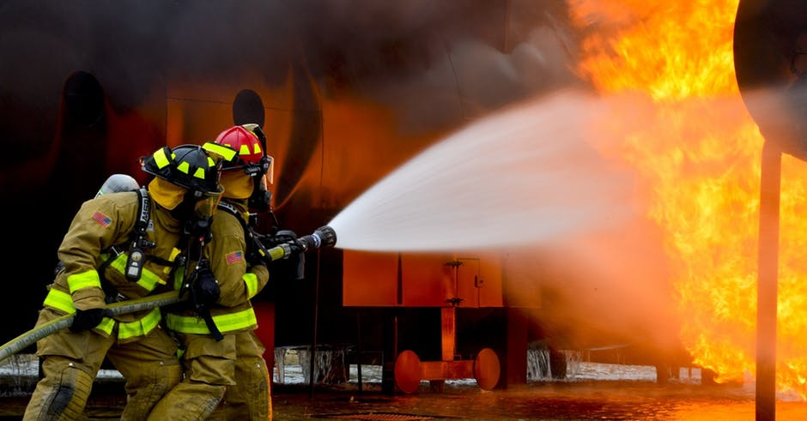
WORK CAN BE LIFE OR DEATH
©Pixabay

Slide 7
LET‘S TALK ABOUT SAFETY & HEALTH

Slide 8
2 MILLION
WORK-RELATED FATAL DISEASES

Slide 9
340 MILLION
WORK ACCIDENTS WORLDWIDE

Slide 10








360,000 FAMILIES: ONE MISSING
©Negative Space
©Pixabay
©Josh Willink
©Freestock.org
©Pixabay
©Pixabay
©Tookapic
© Tadeusz Domagalski

Slide 11
4.0%
ANNUAL ECONOMIC LOSS WORLDWIDE

Slide 12
?

Slide 13
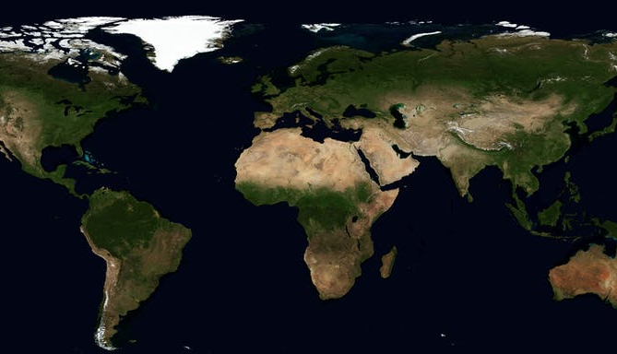

©Pixabay

Slide 14
VISION ZERO
PREVENTION STRATEGY for a safe and healthy future
EVERY accident is preventable
NO work fatalities
NO SERIOUS occupational diseases, work or traffic accidents

Slide 15
IMPLEMENTATION

Slide 16
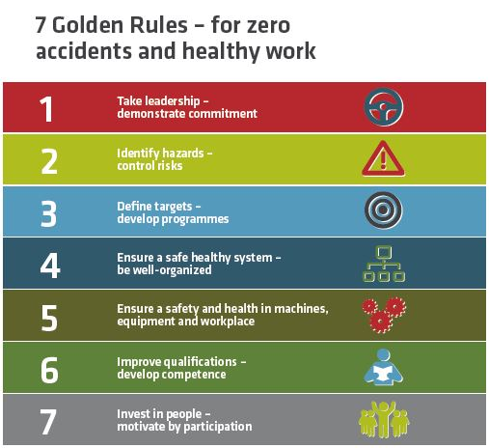

Slide 17

1
Take leadership – demonstrate commitment

Slide 18
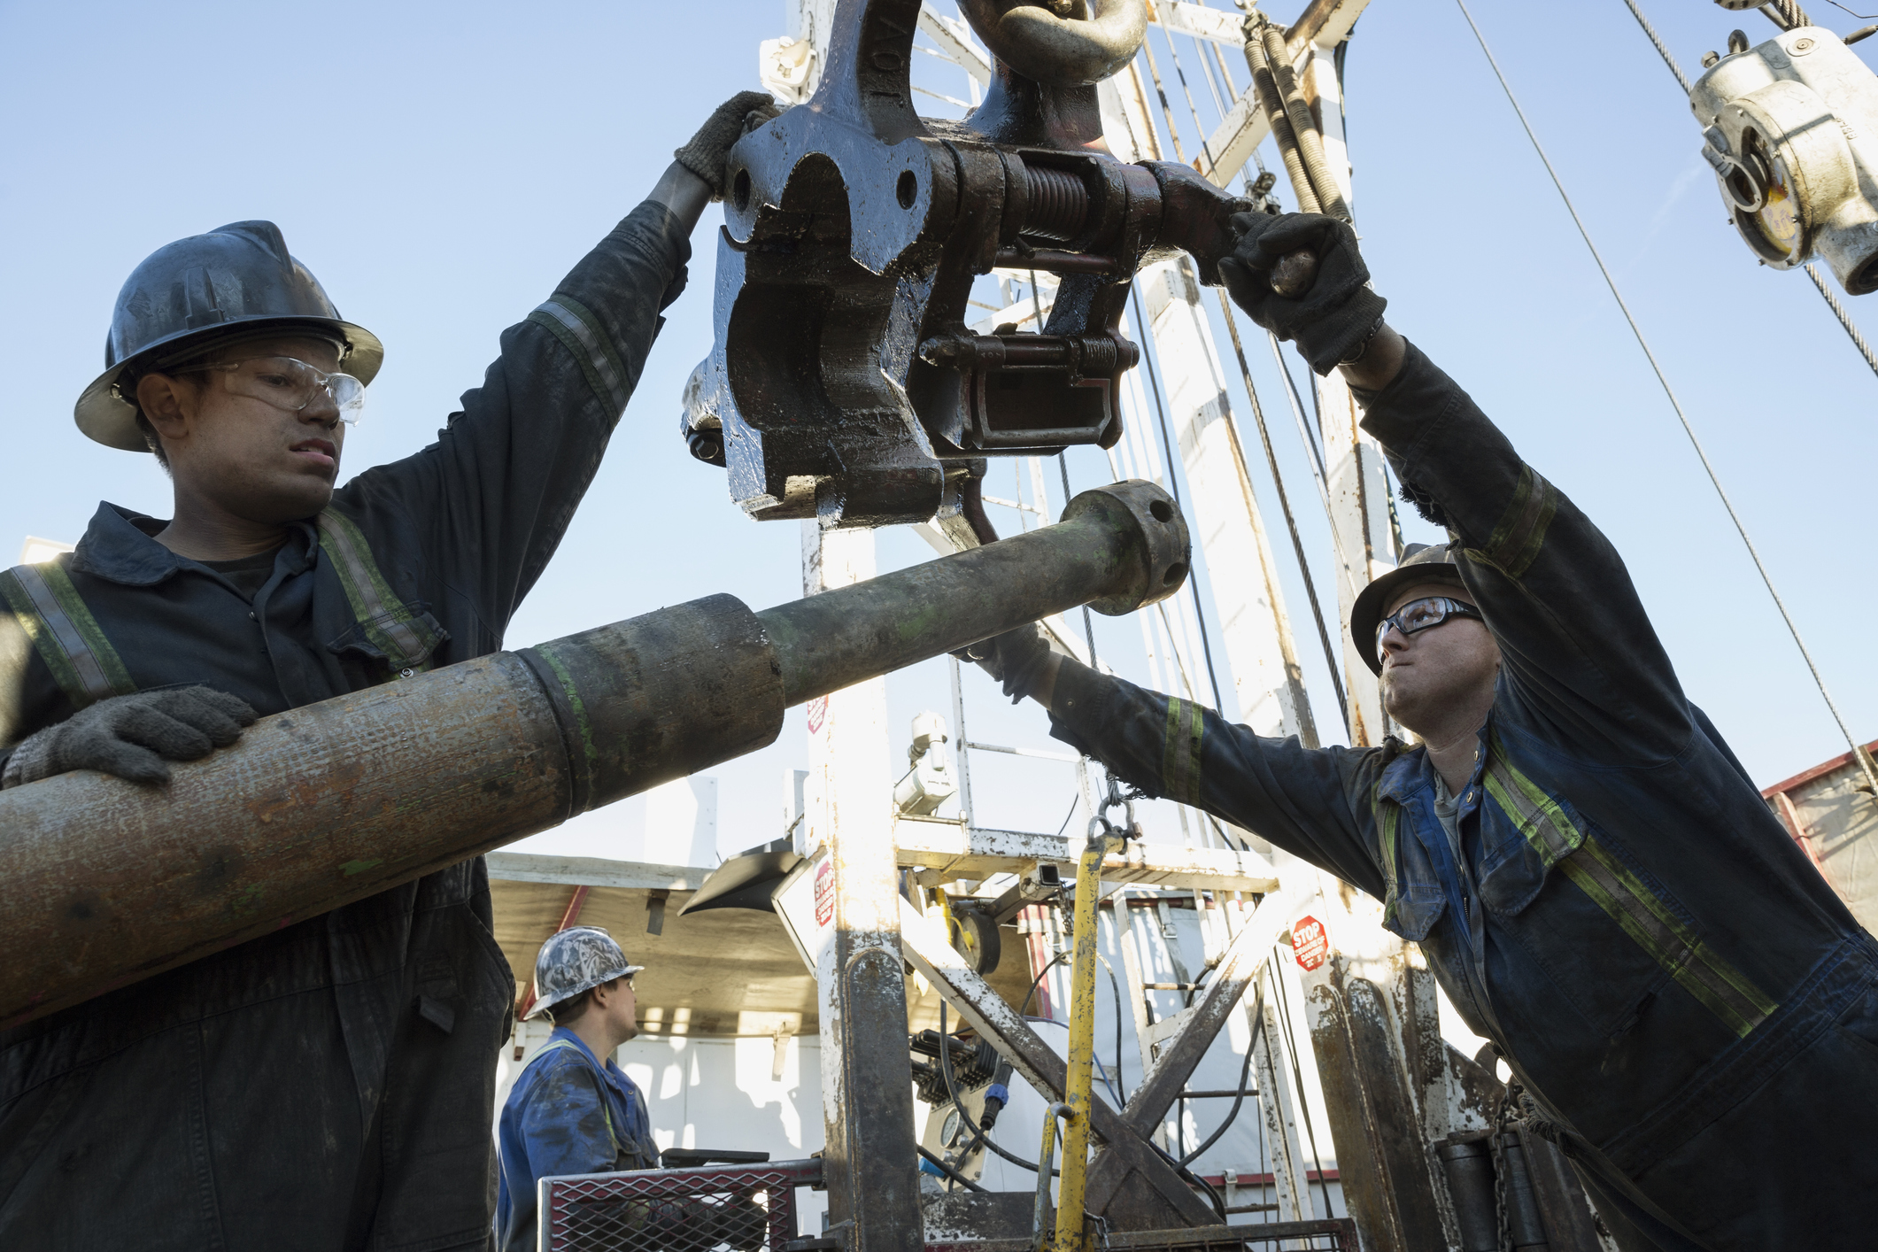
2
Identify hazards–
control risks

Slide 19

3
Define targets–
Develop programmes

Slide 20
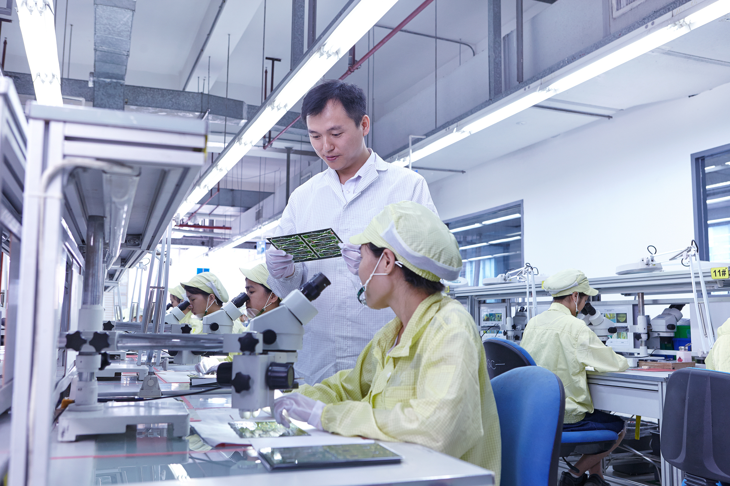
4
Ensure a safe and healthy system–
be well-organized

Slide 21

5
Ensure safety and health in machines, equipment and workplaces

Slide 22

6
Improve qualifications–
develop competence

Slide 23

7
Invest in people –
motivate by participation

