Slide 1
VISION ZERO.
ZERO HARM – HEALTHY WORK!
15.05.2017
Name Speaker

Slide 2

GOOD WORK FOR
GOOD LIFE

Slide 3
BUT WORK HAS OTHER FACES

Slide 4
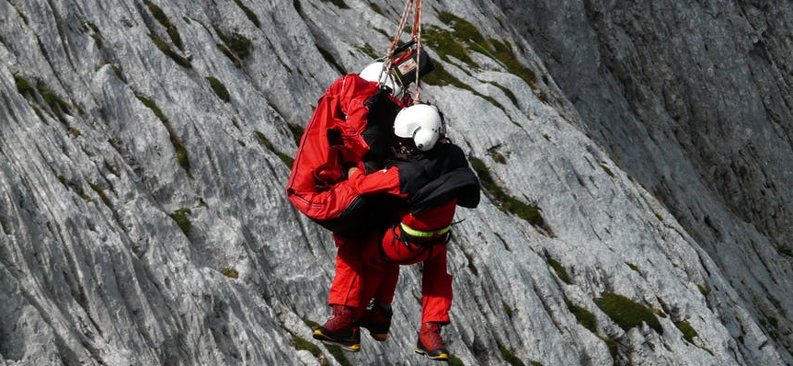
WORK
HURTS

Slide 5

WORK CAN MAKE
YOU SICK

Slide 6

WORK CAN BE
LIFE OR DEATH

Slide 7
LET‘S TALK ABOUT SAFETY & HEALTH

Slide 8
2 Million work-related fatal diseases

Slide 9
340 Million work accidents worldwide

Slide 10
360,000 Families: one missing

Slide 11
4.0% annual economic loss worldwide

Slide 12
?

Slide 13
VISION ZERO
ZERO HARM – HEALTHY WORK

Slide 14
VISION ZERO.
ZERO HARM – HEALTHY WORK!
Is a PREVENTION STRATEGY for a safe & healthy future.
EVERY accident is preventable!
NOBODY gets killed at work!
NO SERIOUS occupational diseases, work accidents or traffic accidents!

Slide 15
VISION ZERO.
IMPLEMENTATION

Slide 16
VISION ZERO.
7 GOLDEN RULES

Slide 18

7
1
Take
Leadership
Invest in
People
2
Improve
Qualifications
6
Identify
Hazards
Ensure Safe
Technology
3
Define
Targets
5
Ensure
Safe Syst.
4

Slide 19

Take leadership demonstrate commitment
1

Slide 20
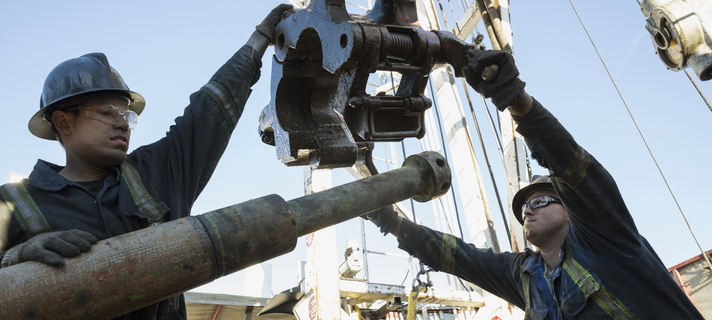
Identify hazards control risks
2

Slide 21

Define targets develop programmes
3

Slide 22
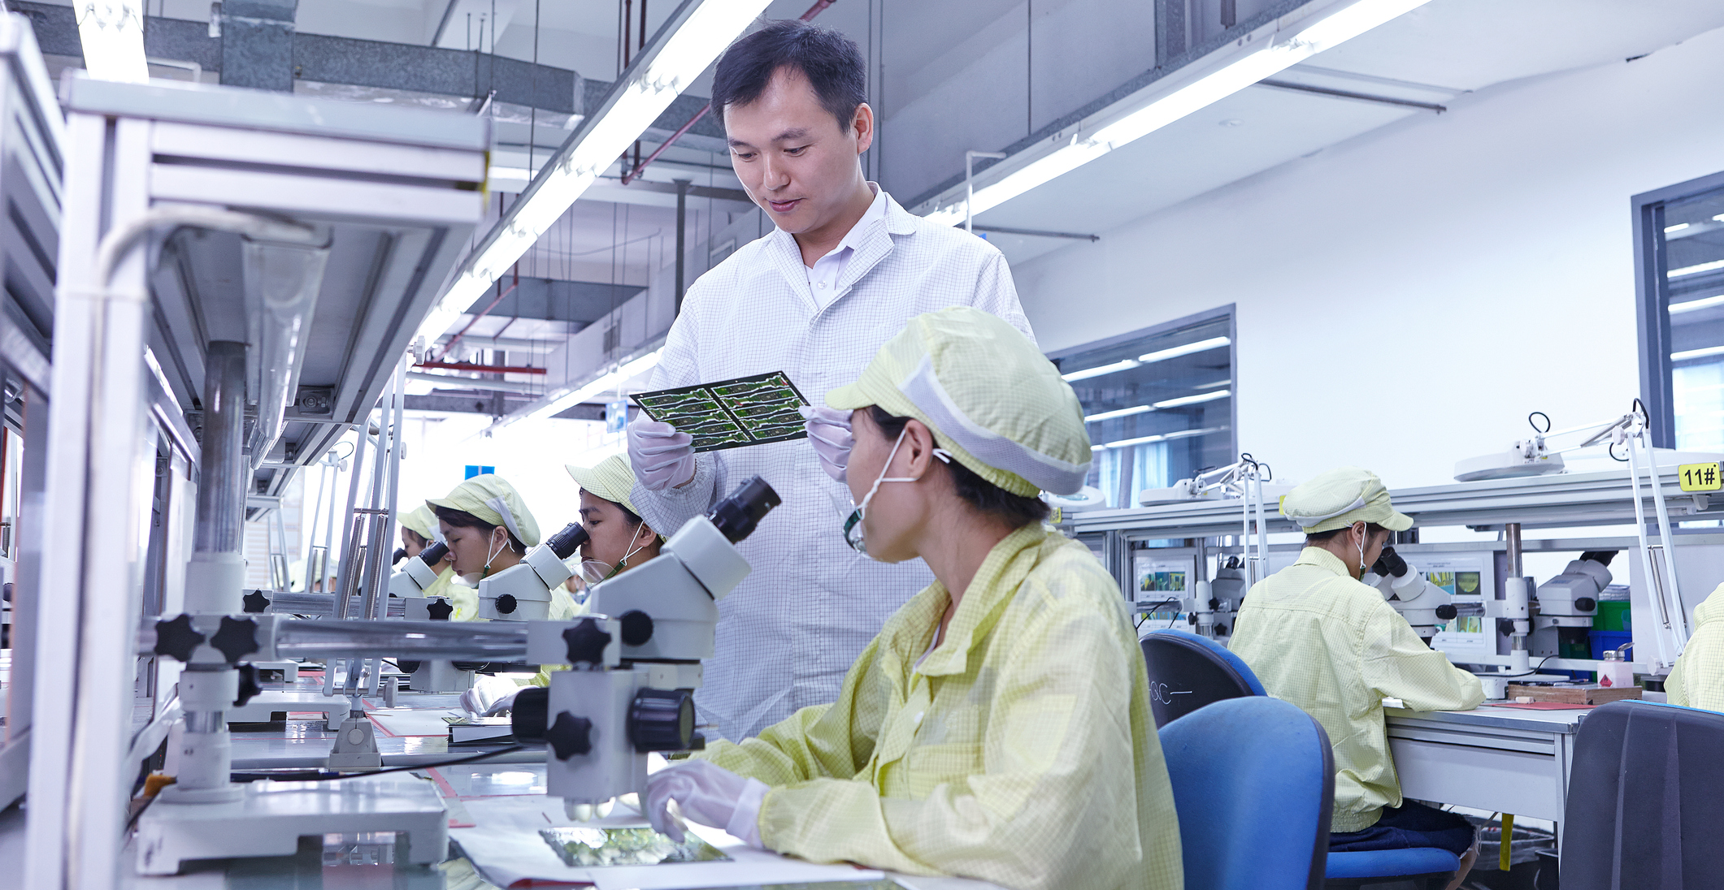
Ensure a safe and healthy system be well-organized
4

Slide 23

Ensure safety and health in machines, equipment and workplaces
5

Slide 24

Improve qualifications develop competence
6

Slide 25

Invest in people motivate by participation
7

